Slide 1
CS6460 Final Presentation
A Study on Student Engagement and Learning Outcomes in Online Learning
Cleo Zhang
yzhang3761@gmail.com

Slide 2
Overview
Background
Intro
Methodology
Activity Design
Data Collection
Experiment Design
Data Analysis Methods
Data Analysis and Charts
Observations and Results
Conclusion
Discussion
Critique
Future Work

Slide 3


Background

Slide 4



Intro
My involvement with Tapestry sparked my interest in the EdTech field.
In the CS6460 Research track, I‘m studying the important role of educational software in boosting student engagement in online learning.

Slide 5

Methodology - Activity Design

Slide 6

Methodology - Data Collection
What I Collected:
Participants' weekly feedback
their final thoughts on the whole learning experience
How I Collected:
Send reminder every Friday
Receive Feedback via emails

Slide 7

Methodology – Experiment Design
Controlled Experiments
18 Participants in total
Goal: Student Engagement and Learning Outcomes in Online Learning context.
Approach: Participants were randomly grouped into experimental and control groups

Slide 8


Methodology – Data Analysis Methods
Quantitively Analysis
Qualitative Analysis
For analysis purposes, I will primarily use quantitative and qualitative analysis, as well as a combination of the two.

Slide 9
Data Analysis - Student Engagement 1
This Double Line Chart shows the total number of words fed back by participants in the Experimental and Control groups.
It is clear that the experimental group sent feedback with more text each week than the control group, implying the participants who used Duolingo to learn the new language were more during the learning process than those who used the traditional method.

Slide 10
Data Analysis - Student Engagement 2
This Area-Line Combined Chart shows the cumulative amount of feedback from the experimental group has a steeper and more steady growth curve than the control one, which means that participants who used Duolingo had more stable learning behaviours and engagement levels throughout the learning activity, while the control group’s engagement was decreasing.

Slide 11
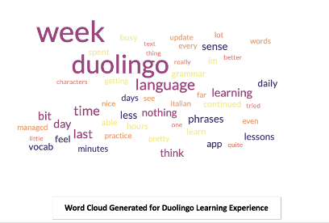
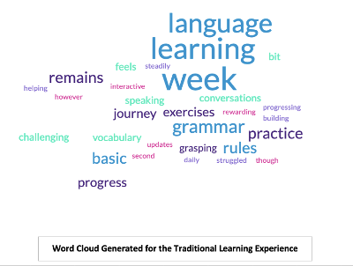
Data Analysis – Learning Process
The keyword "learning" appears more often in the feedback from the control group
Descriptive words such as "challenged" and "struggled" appeared more often in the control group than in the experimental group
From the participants' feedback, it seems that the two groups of participants have a different focus on learning languages through different learning approaches

Slide 12

Data Analysis – Learning Outcomes Evaluation
Since I have not received any feedback from the control group participants in the final week and infeasibility of online language testing for both groups, the outcomes are evaluated through existing research and previous quantitative analysis.
Richardson and Swan (2003) and Garrison and Vaughan's (2008)’s research supports the positive correlation between learning engagement and final outcomes.
Since analysis has shown that the experimental group using Duolingo had a higher engagement level compared to the control group, the experimental group is supposed to have better outcomes in learning the new language than the control group.

Slide 13

Conclusion
Learning Engagement:
Duolingo users consistently displayed higher feedback and word counts, indicating sustained engagement.
Cumulative feedback for Duolingo users exhibited a steady growth curve, contrasting with declining engagement in the control group.
Learning Process:
Duolingo users emphasized sensory experiences.
Control group focused on vocabulary and grammar.
Learning Outcomes:
The Experimental Group is expected to have better learning outcomes than the control Group

Slide 14



Discussion - Critique
The data collected is limited regarding the time frame and number of participants, resulting in a Limited Scope for Generalization and Sampling Bias.
Participants are learning different languages, which have different learning curves – hard to assess participants' learning behaviors under the same standard.
Mechanical intervention by the researcher and the external makes the data hardly reflect reality

Slide 15



Discussion - Future Work
The impact of the researcher's intervention on the study participants, regarding the data collection and the analysis results - Findings in this track help researchers revisit their experimentation flow in educational technology to obtain more reliable results.
Implicit assessment of online learning outcomes - Research on implicit assessment of online learning outcomes can benefit educational technology by providing nuanced insights into learners' subconscious knowledge retention and skill acquisition.
Effects of repetitive behaviours on learning - it is meaningful to discuss how the form and frequency of repetitive behaviours affect learners' learning status and outcomes.

Slide 16

If you have any questions, please email me at yzhang3761@gmail.com
Thanks for your time!

